Slide 1

Competitive activation of mixed aerosol systems: cloud chamber experiments and modelling studies
Nsikanabasi S. Umo¹, Paul Connolly*², Kai Bi³, Sisi Chen⁴, Zhaoze Deng⁵, Javier Etcheto¹, Yaqiong Hu¹, Najin Kim⁶, Nicole Riemer⁷, Wenhan Tang⁷, David Topping², Robert Wagner¹, Xiaotian Xu⁷, Lulin Xue⁴, Seong Soo Yum⁸, Bowen Zhu², and Ottmar Möhler^{§1}
¹Institute of Meteorology and Climate Research - Atmospheric Aerosol Research, Karlsruhe Institute of Technology (KIT), Germany
²Centre for Atmospheric sciences, University of Manchester, UK
³Beijing Weather Modification Centre, China
⁴Research Applications Laboratory, National Centre for Atmospheric Research, USA
⁵Key Laboratory of Middle Atmosphere and Global Environment Observation, Institute of Atmospheric Physics, CAS, China
⁶Korea Institute of Science and Technology, South Korea
⁷Department of Atmospheric Sciences, University of Illinois, USA
⁸Department of Atmospheric Sciences, Yonsei University, South Korea
*paul.connolly@manchester.ac.uk
§ottmar.mohler@kit.edu
11th ICMW 2024, Yonsei University, Seoul, South Korea
11:00 – 11:20, 08.07.2024

Slide 2
Contents of this talk…
The Importance of Cloud Process Modelling
The Organization of the Study – Laboratory Experiments & Modelling
The AIDAd Aerosol & Cloud simulation Chamber
Preliminary Results
Implications of the Study + Summary
Further Data Processing and the Way Forward

Slide 3
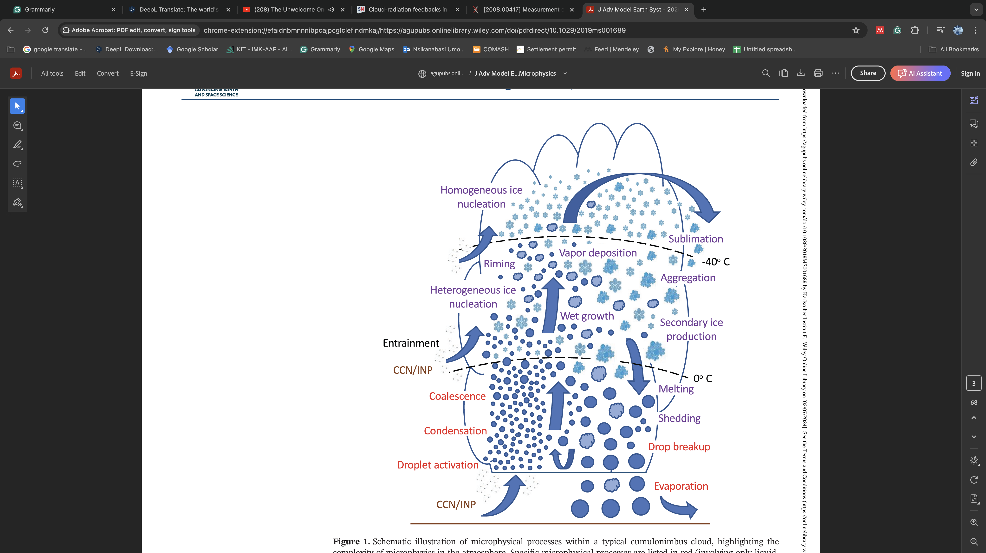
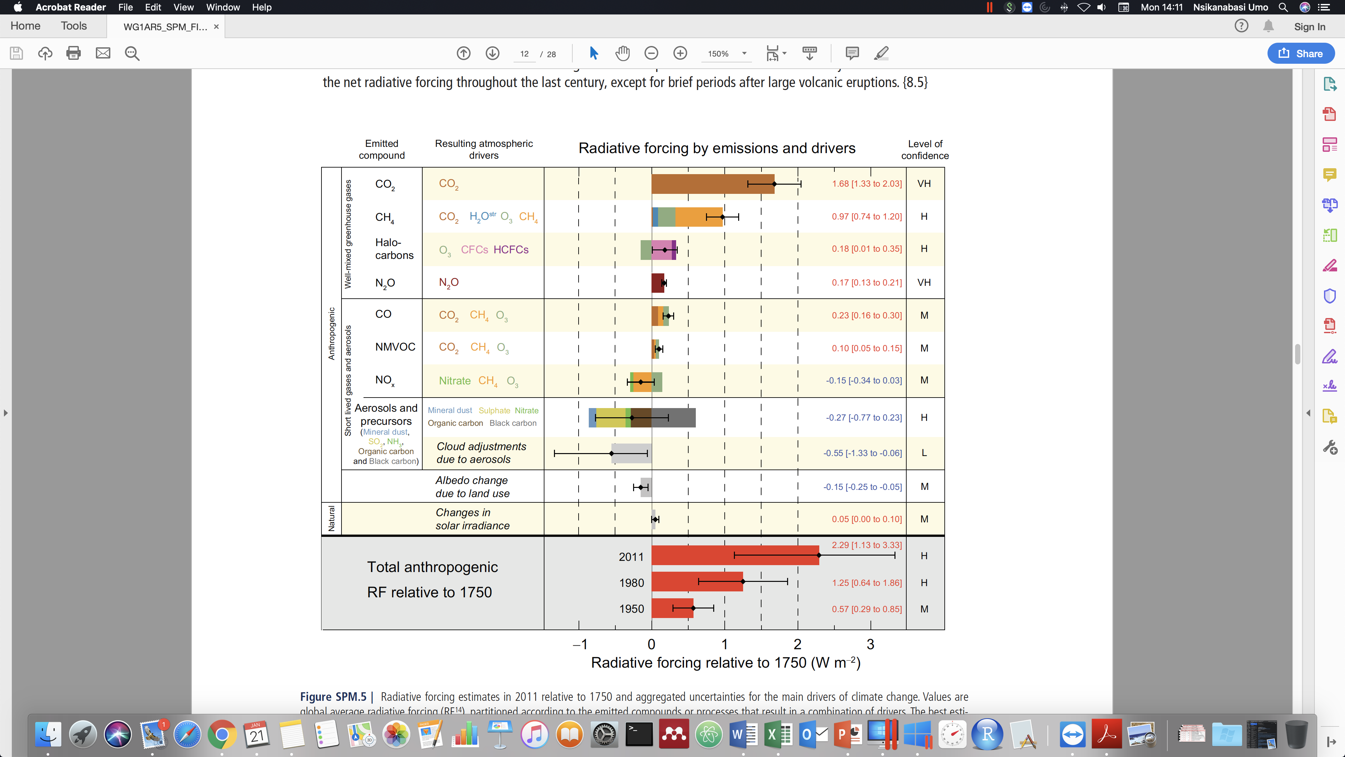

Why we consider cloud process modelling important!
Complex processes in the atmosphere
Difficulty in varying all the parameters in laboratory experiments
Our understanding is still limited – the uncertainly is still high (IPCC, 2021)
Morrison et al., 2020, IPCC, 2021

Slide 4
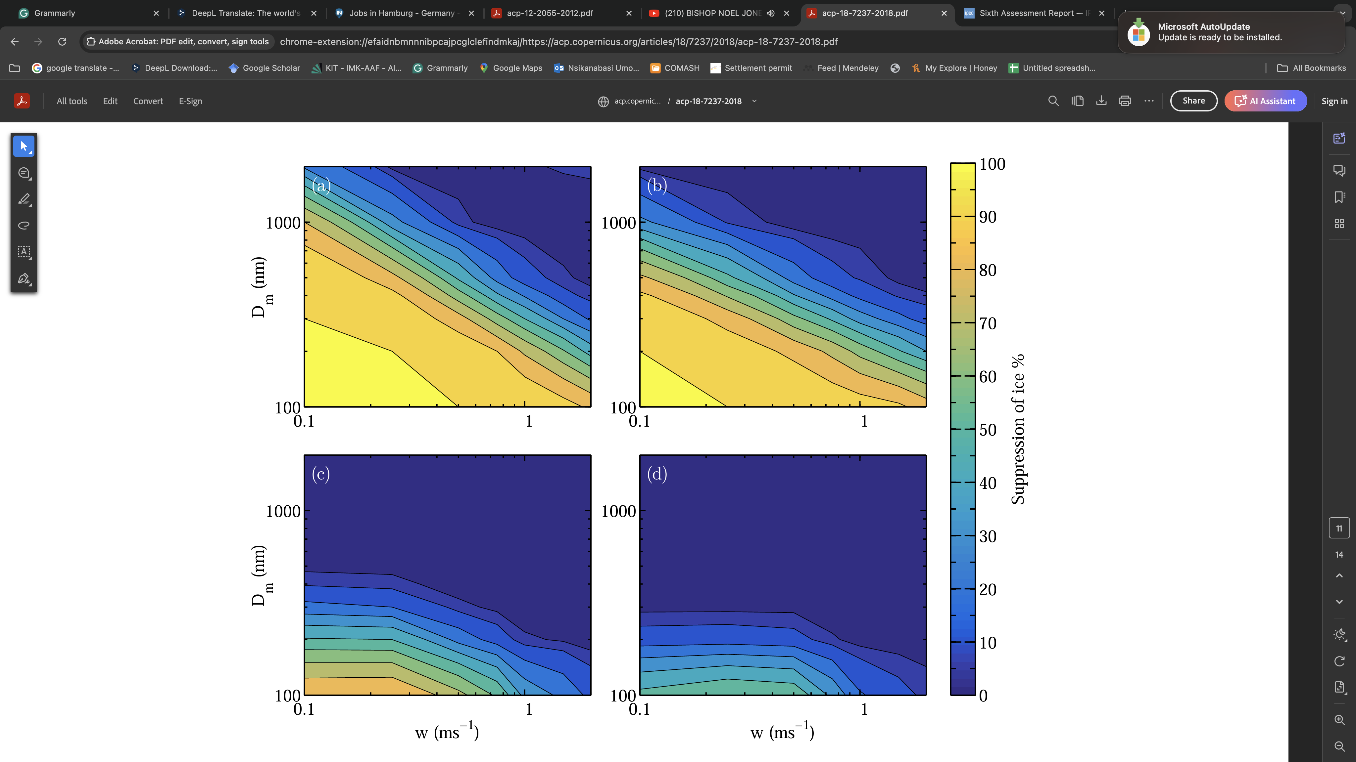
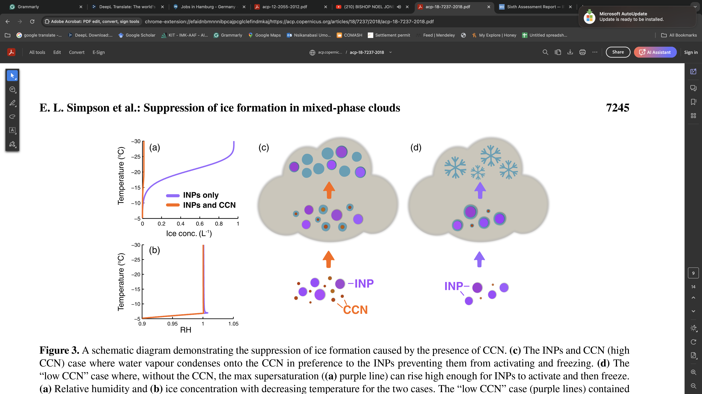
The key research questions to address…
Competition in droplets activation of aerosols
Suppression of ice by competition effect!?
What happens with external mixtures of aerosol particles?
Simpson et al. 2018, ACP

Slide 5










The Birth of ‘iSKYLAB’ Project
improved Scientific Knowledge of Clouds, Ice CrYstals, and Aerosols through LABoratory Access of a New Dynamic Cloud Chamber (iSKYLAB)
Laboratory experiments & Modelling
Paul Connolly, University of Manchester, UK [PI]
17 Scientists
8 Institutions | 4 Continents
Funding: EU Transnational Access (TNA) + Helmholtz Association via KIT
iSKYLAB

Slide 6
Scientific Objectives of the ‘iSKYLAB’ Project
iSKYLAB is designed to perform quantitative experiments to understand the competition effects between aerosol particles.
Specific Objectives
To perform experiments into the activation of droplets on single component aerosol and external aerosol mixtures with the new AIDAd chamber.
To investigate the activation of both INPs and CCN in order to understand whether the competition effects proposed by Simpson et al. (2018) holds.
To test results from #1 & #2 quantitatively against the ACPIM model, the Lagrangian-particle-based DNS model, and the PartMC model whether they are able to capture competition effects due to 'size effects’.
Simpson et al. 2018, ACP

Slide 7
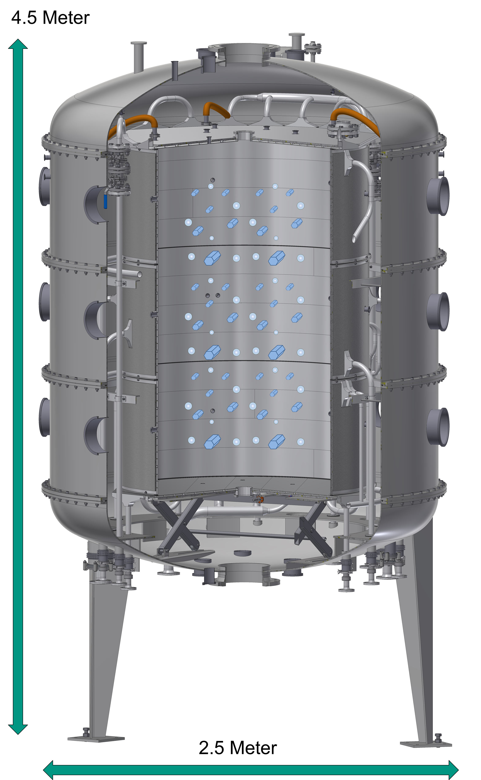
iSKYLAB Study Tools – Laboratory & Modelling
Laboratory
AIDAd
INSEKT
Lagrangian-particle-based DNS Model
ACPIM Model
PartMC Model
Modelling
University of Manchester
University of Illinois
NCAR

Slide 8
ACPIM Model
Notes:
Impacts of VA – Visibility, Aviation, Air quality/health, Direct influence on solar radiation (RF), Atmospheric aerosol sink/substrate for atmospheric biogeochemical reactions, Nutrient source , Ice-nucleating particles (INPs) – indirect effect

Slide 9
PartMC Model
Notes:
Impacts of VA – Visibility, Aviation, Air quality/health, Direct influence on solar radiation (RF), Atmospheric aerosol sink/substrate for atmospheric biogeochemical reactions, Nutrient source , Ice-nucleating particles (INPs) – indirect effect

Slide 10
Lagrangian-particle-based DNS Model
Notes:
Impacts of VA – Visibility, Aviation, Air quality/health, Direct influence on solar radiation (RF), Atmospheric aerosol sink/substrate for atmospheric biogeochemical reactions, Nutrient source , Ice-nucleating particles (INPs) – indirect effect

Slide 11
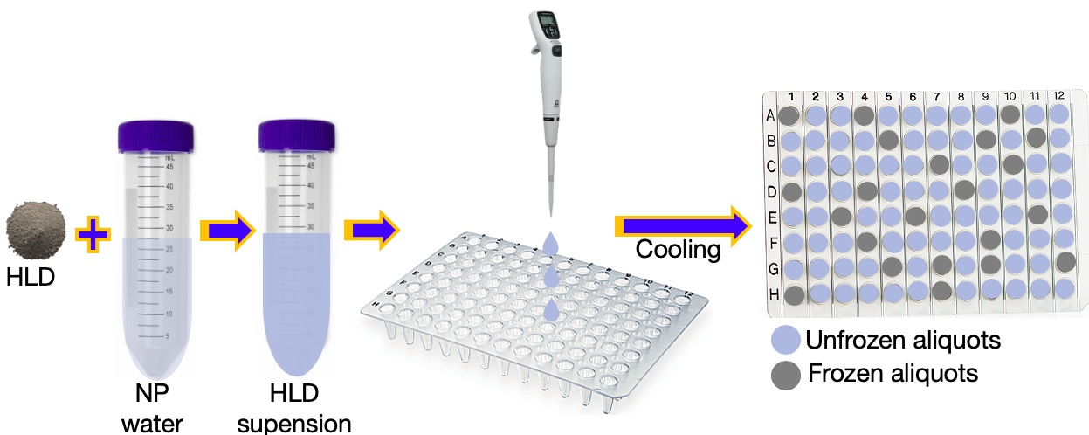
Experimental Set-up@INSEKT
Ice Nucleation SpEctrometer of the Karlsruhe Institute of Technology (INSEKT)
(a type of cold-stage (wells?) freezing assay)
Notes:
Impacts of VA – Visibility, Aviation, Air quality/health, Direct influence on solar radiation (RF), Atmospheric aerosol sink/substrate for atmospheric biogeochemical reactions, Nutrient source , Ice-nucleating particles (INPs) – indirect effect

Slide 12
The AIDAd Aerosol & Cloud Simulation Chamber
AIDAd = Atmospheric Interactions and Dynamics in the Atmosphere (dynamic).
It is a unique facility for cloud process studies It can simulate convective clouds with updrafts up to 15 m s⁻¹.
It has an innovative engineering design with wall cooling during cloud expansion experiments (+30 °C to -55 °C). → isothermal conditions minimise internal heat fluxes and maximise cloud life-time.
It has 5 segments with independent temperature control.
Each segment can be set to any temperature difference between 0 and ±10 K.
It can be operated at constant cooling rates up to 10 K/min with isothermal conditions.

Slide 13
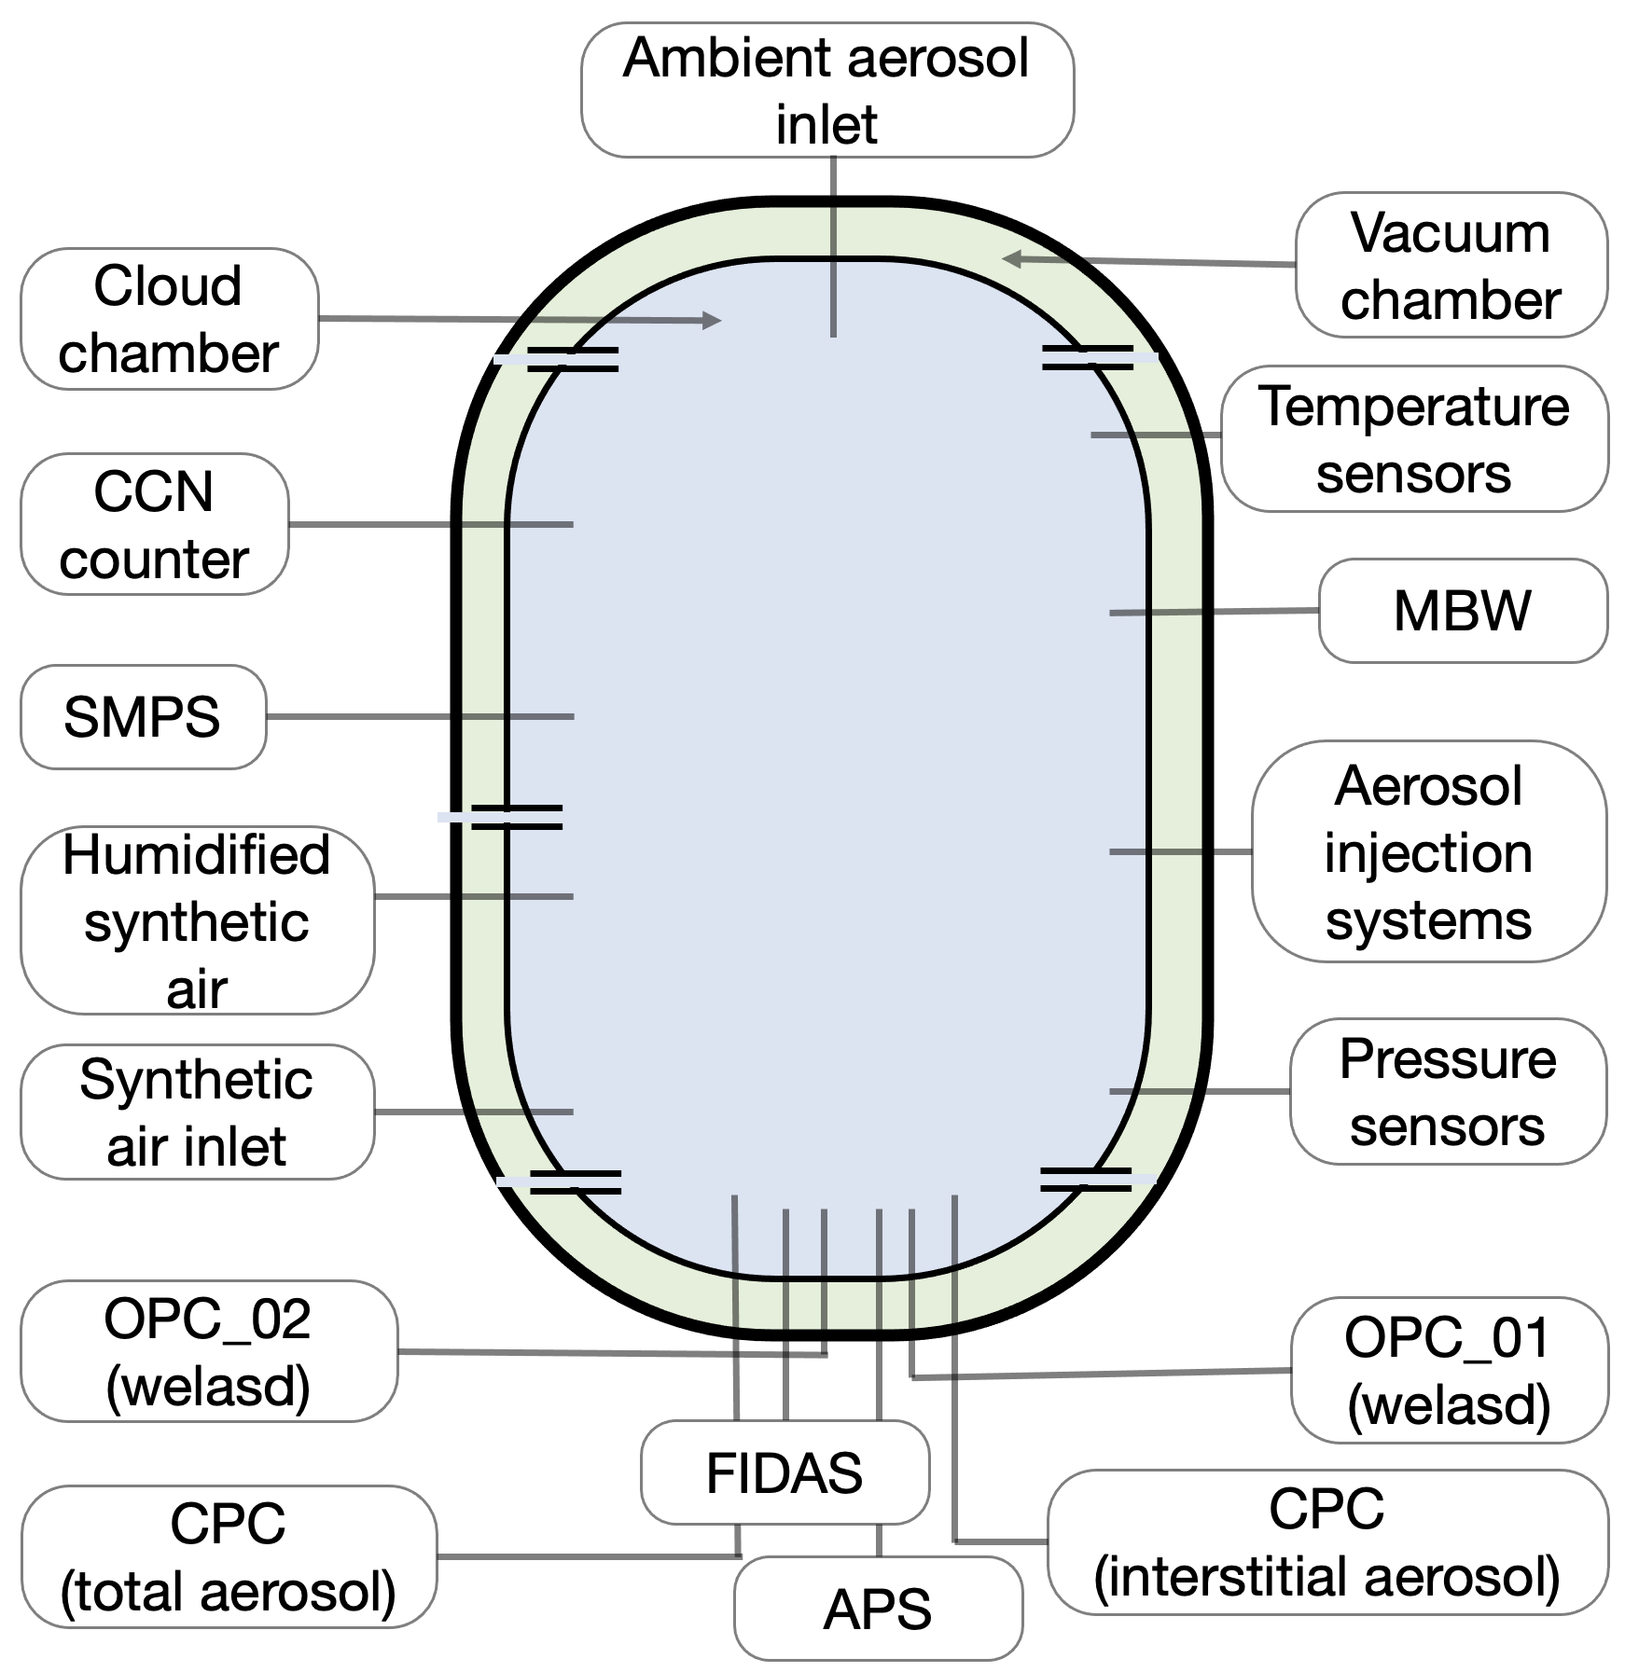
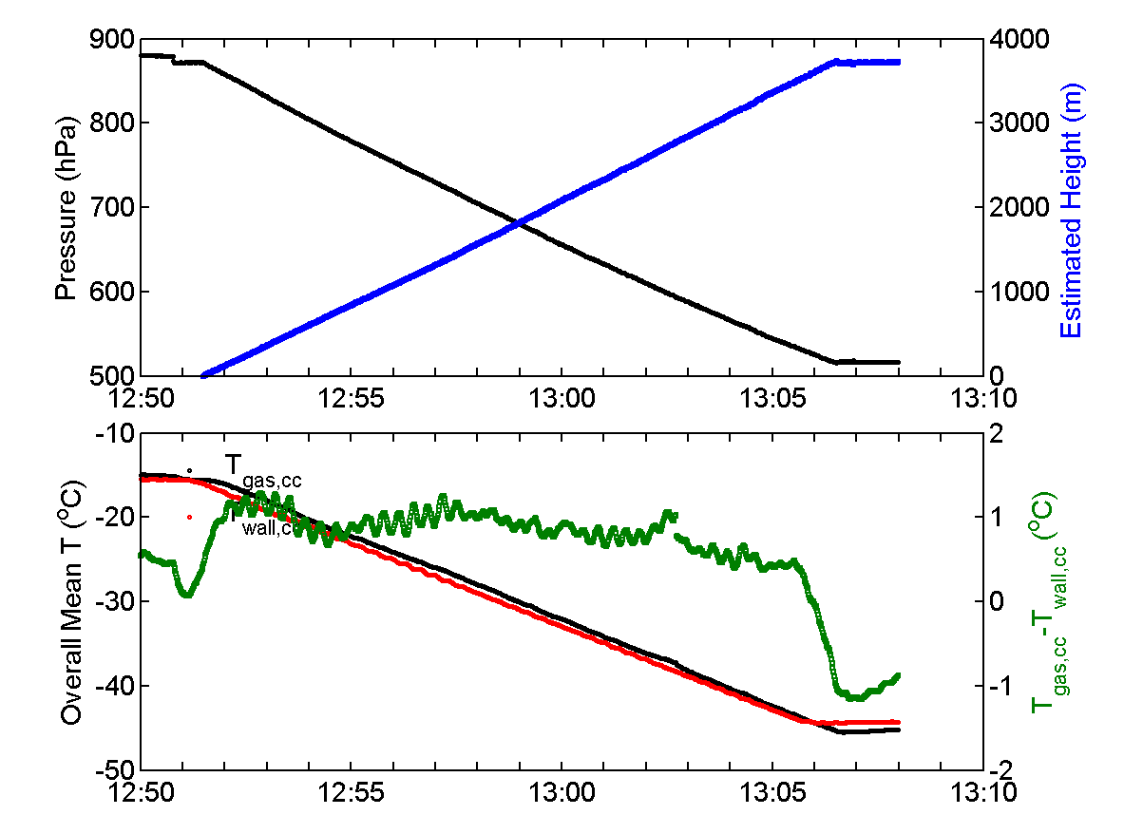
The AIDAd Aerosol & Cloud Simulation Chamber
Because of the active wall-cooling of the AIDAd chamber, a true adiabatic expansion can be achieved.
Replace the schematic!!!

Slide 14
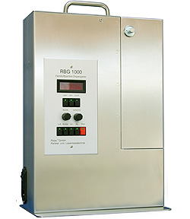
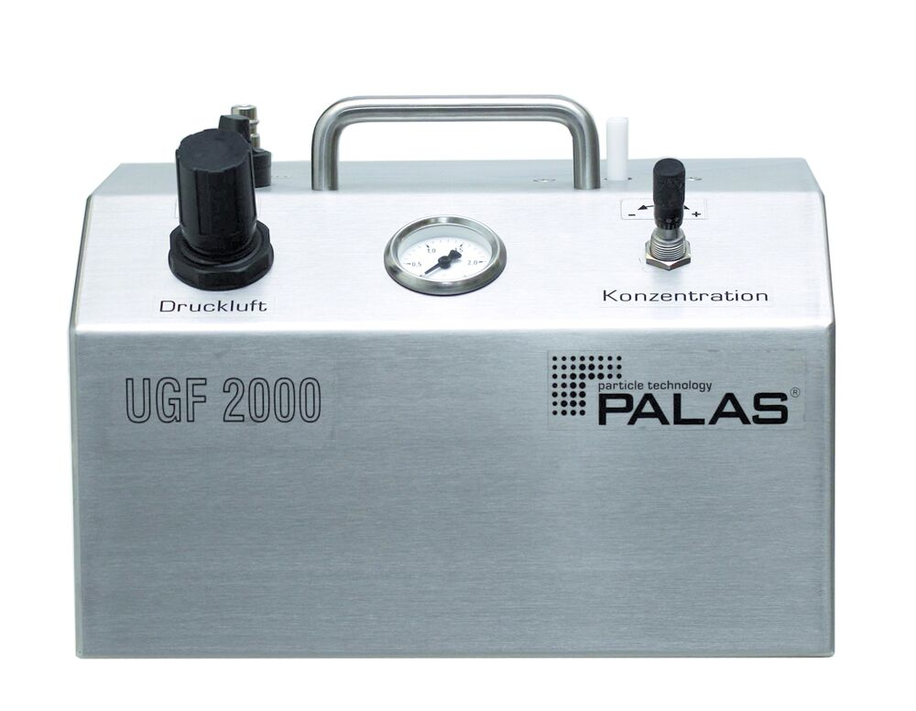
Aerosol systems and experimental plans
Aerosol systems: (NH4)₂SO₄, NaCl, Fulvic acid, SDSA, and ATD
Aerosol generators/injection: RBG, UGF 2000, & Ultrasonic nebuliser
Cooling rates: 0.2, 0.4, and 2 K/min
Exp. No. | Aerosol Type | Target Conc. (#/cm³) | Cooling Rate (K/min)
1 | Background | 0 | 4.0
2 | AS | 500 | 0.5
3 | AS | 5000 | 0.5
4 | AS | 5000 | 0.5
5 | AS | 3000 | 0.5
6 | AS+NaCl | 3000+600 | 0.5
7 | AS+NaCl | 3000+2000 | 0.5
8 | AS+NaCl | 3000+2000 | 0.5
9 | AS+NaCl | 3000+4000 | 0.5
10 | AS+NaCl | 3000+4000 | 0.5
11 | AS | 5000 | 0.5
12 | NaCl | 2000 | 0.5
13 | NaCl | 600 | 0.5
14 | NaCl | 2000 | 0.5
15 | FA | 3000 | 0.5
16 | AS | 3000 | 0.5
17 | AS | 3000 | 4.0
18 | FA+NaCl | 3000+600 | 0.5
19 | FA+NaCl | 3000+2000 | 0.5
20 | SDSA01 | 3000 | 0.5
21 | SDSA01 | 1000 | 0.5
22 | SDSA01+NaCl | 3000+2000 | 0.5
23 | SDSA01+NaCl | 3000+2000 | 0.5
24 | SDTP02 | 1000 | 2.0
25 | ATD03 | 1000 | 0.5
26 | ATD03+NaCl | 1000+4000 | 0.5
27 | ATD03+NaCl | 1000+10000 | 0.5
Uranus

Slide 15
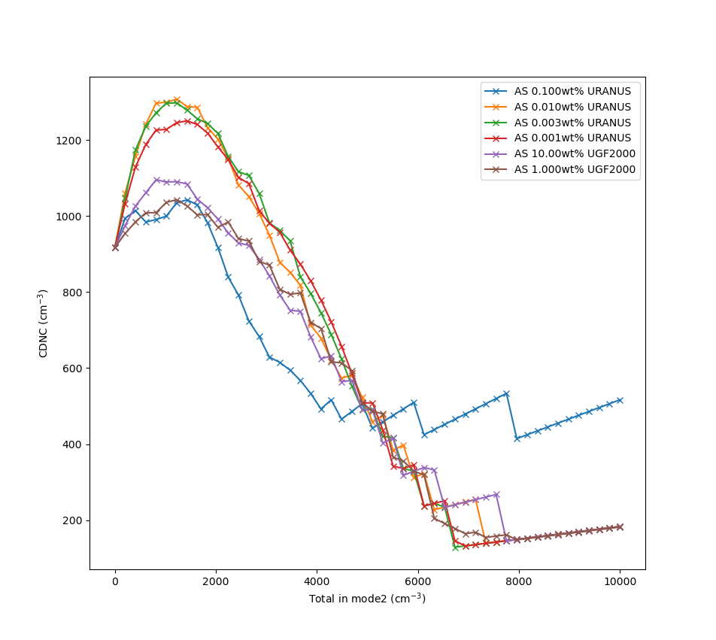
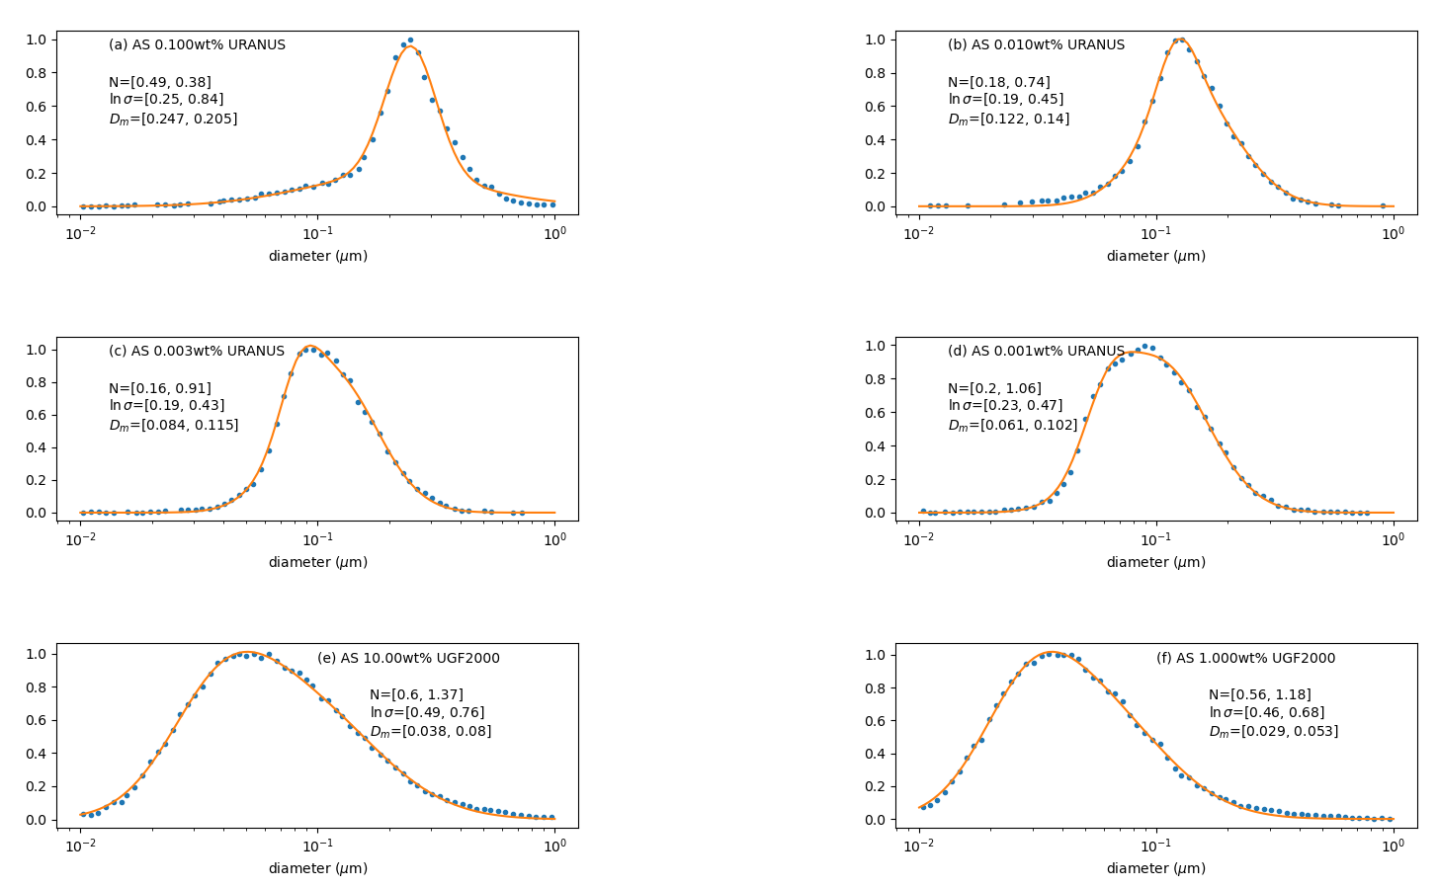
Modelling predictions for the experiments…
Simulation of the particle sizes generated
xxxxxxxxxxxxx
Comparative activation of cloud droplets number concentrations

Slide 16
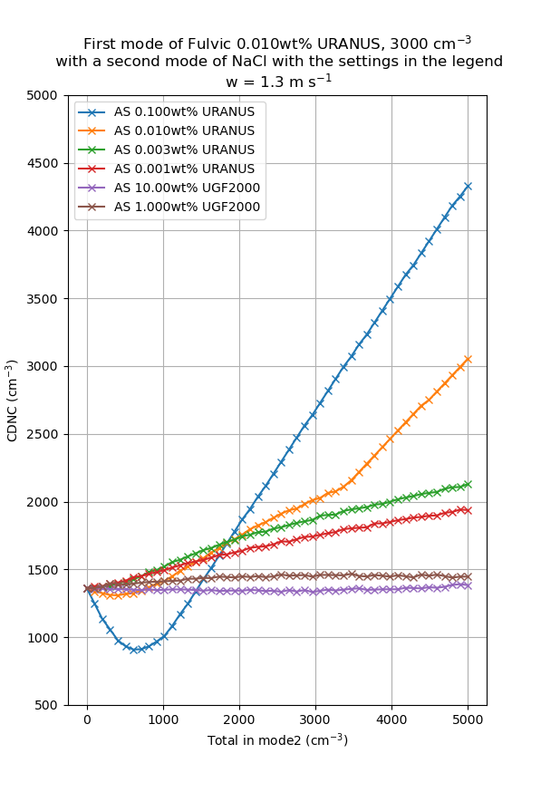
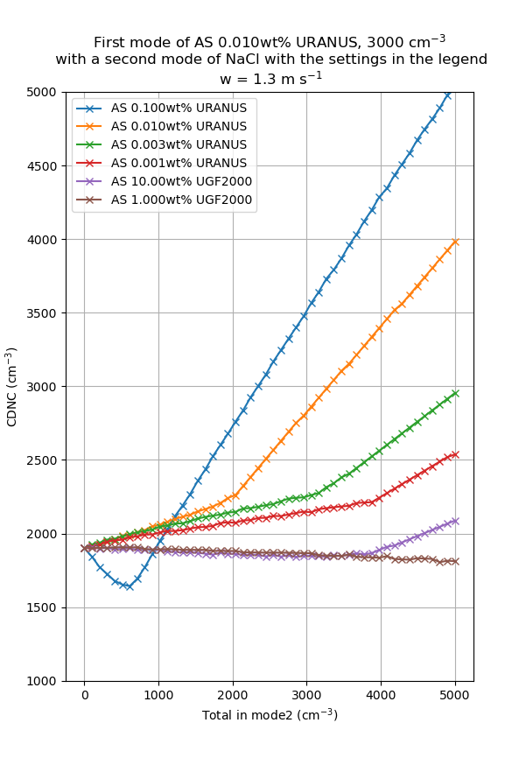
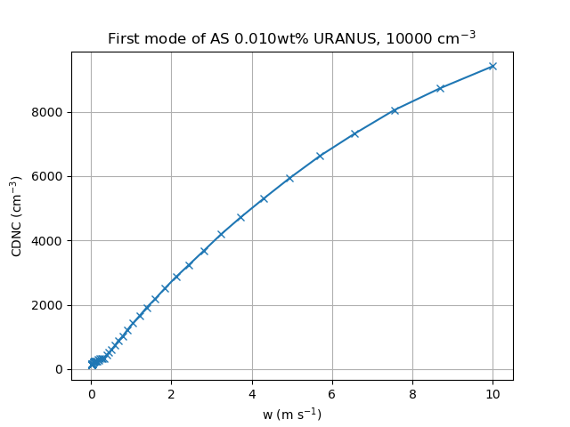
Modelling Predictions for the Experiments…
External mixtures – AS + NaCl
Expected activation
xxxxxxxxxxxxx

Slide 17
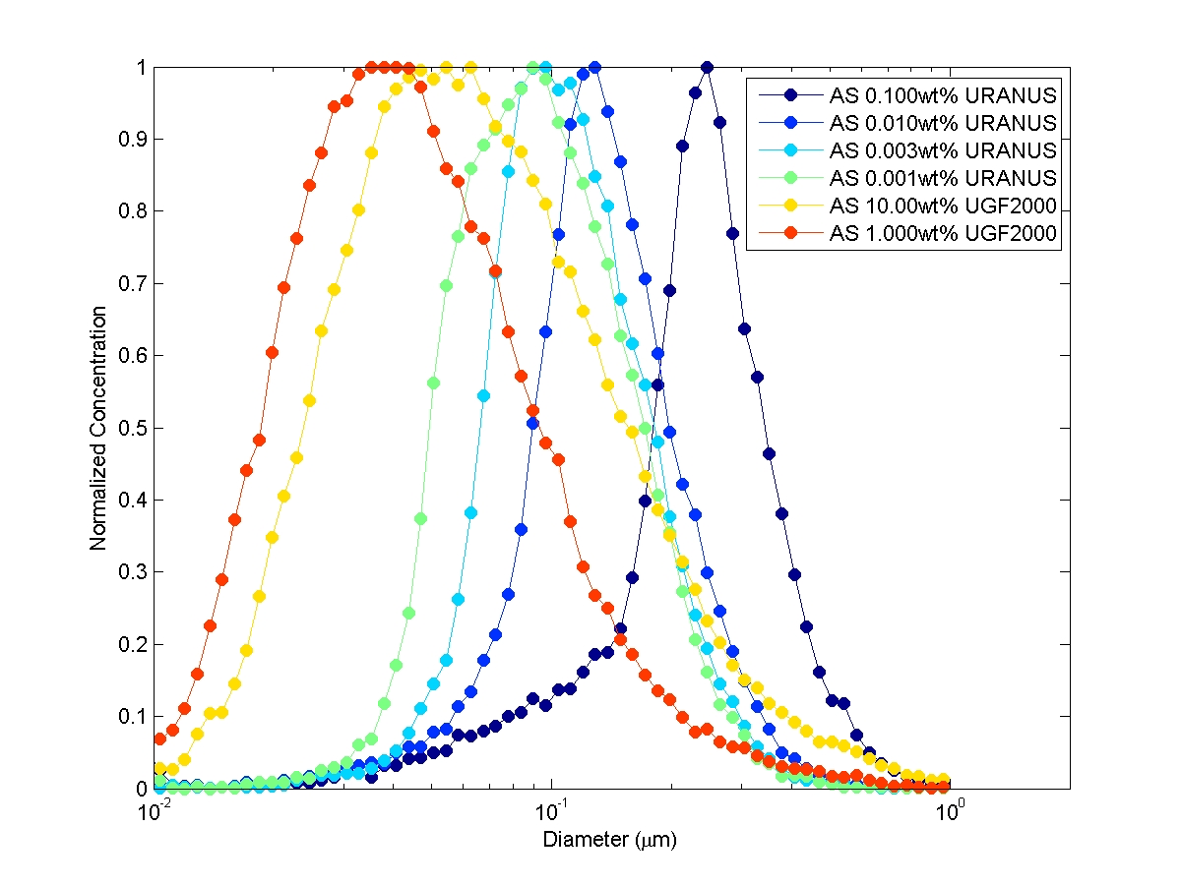
Particle Size Distribution of AS, NaCl, FA and ATD
Size range = …… µm, D_{Med} = …..µm
…………..

Slide 18
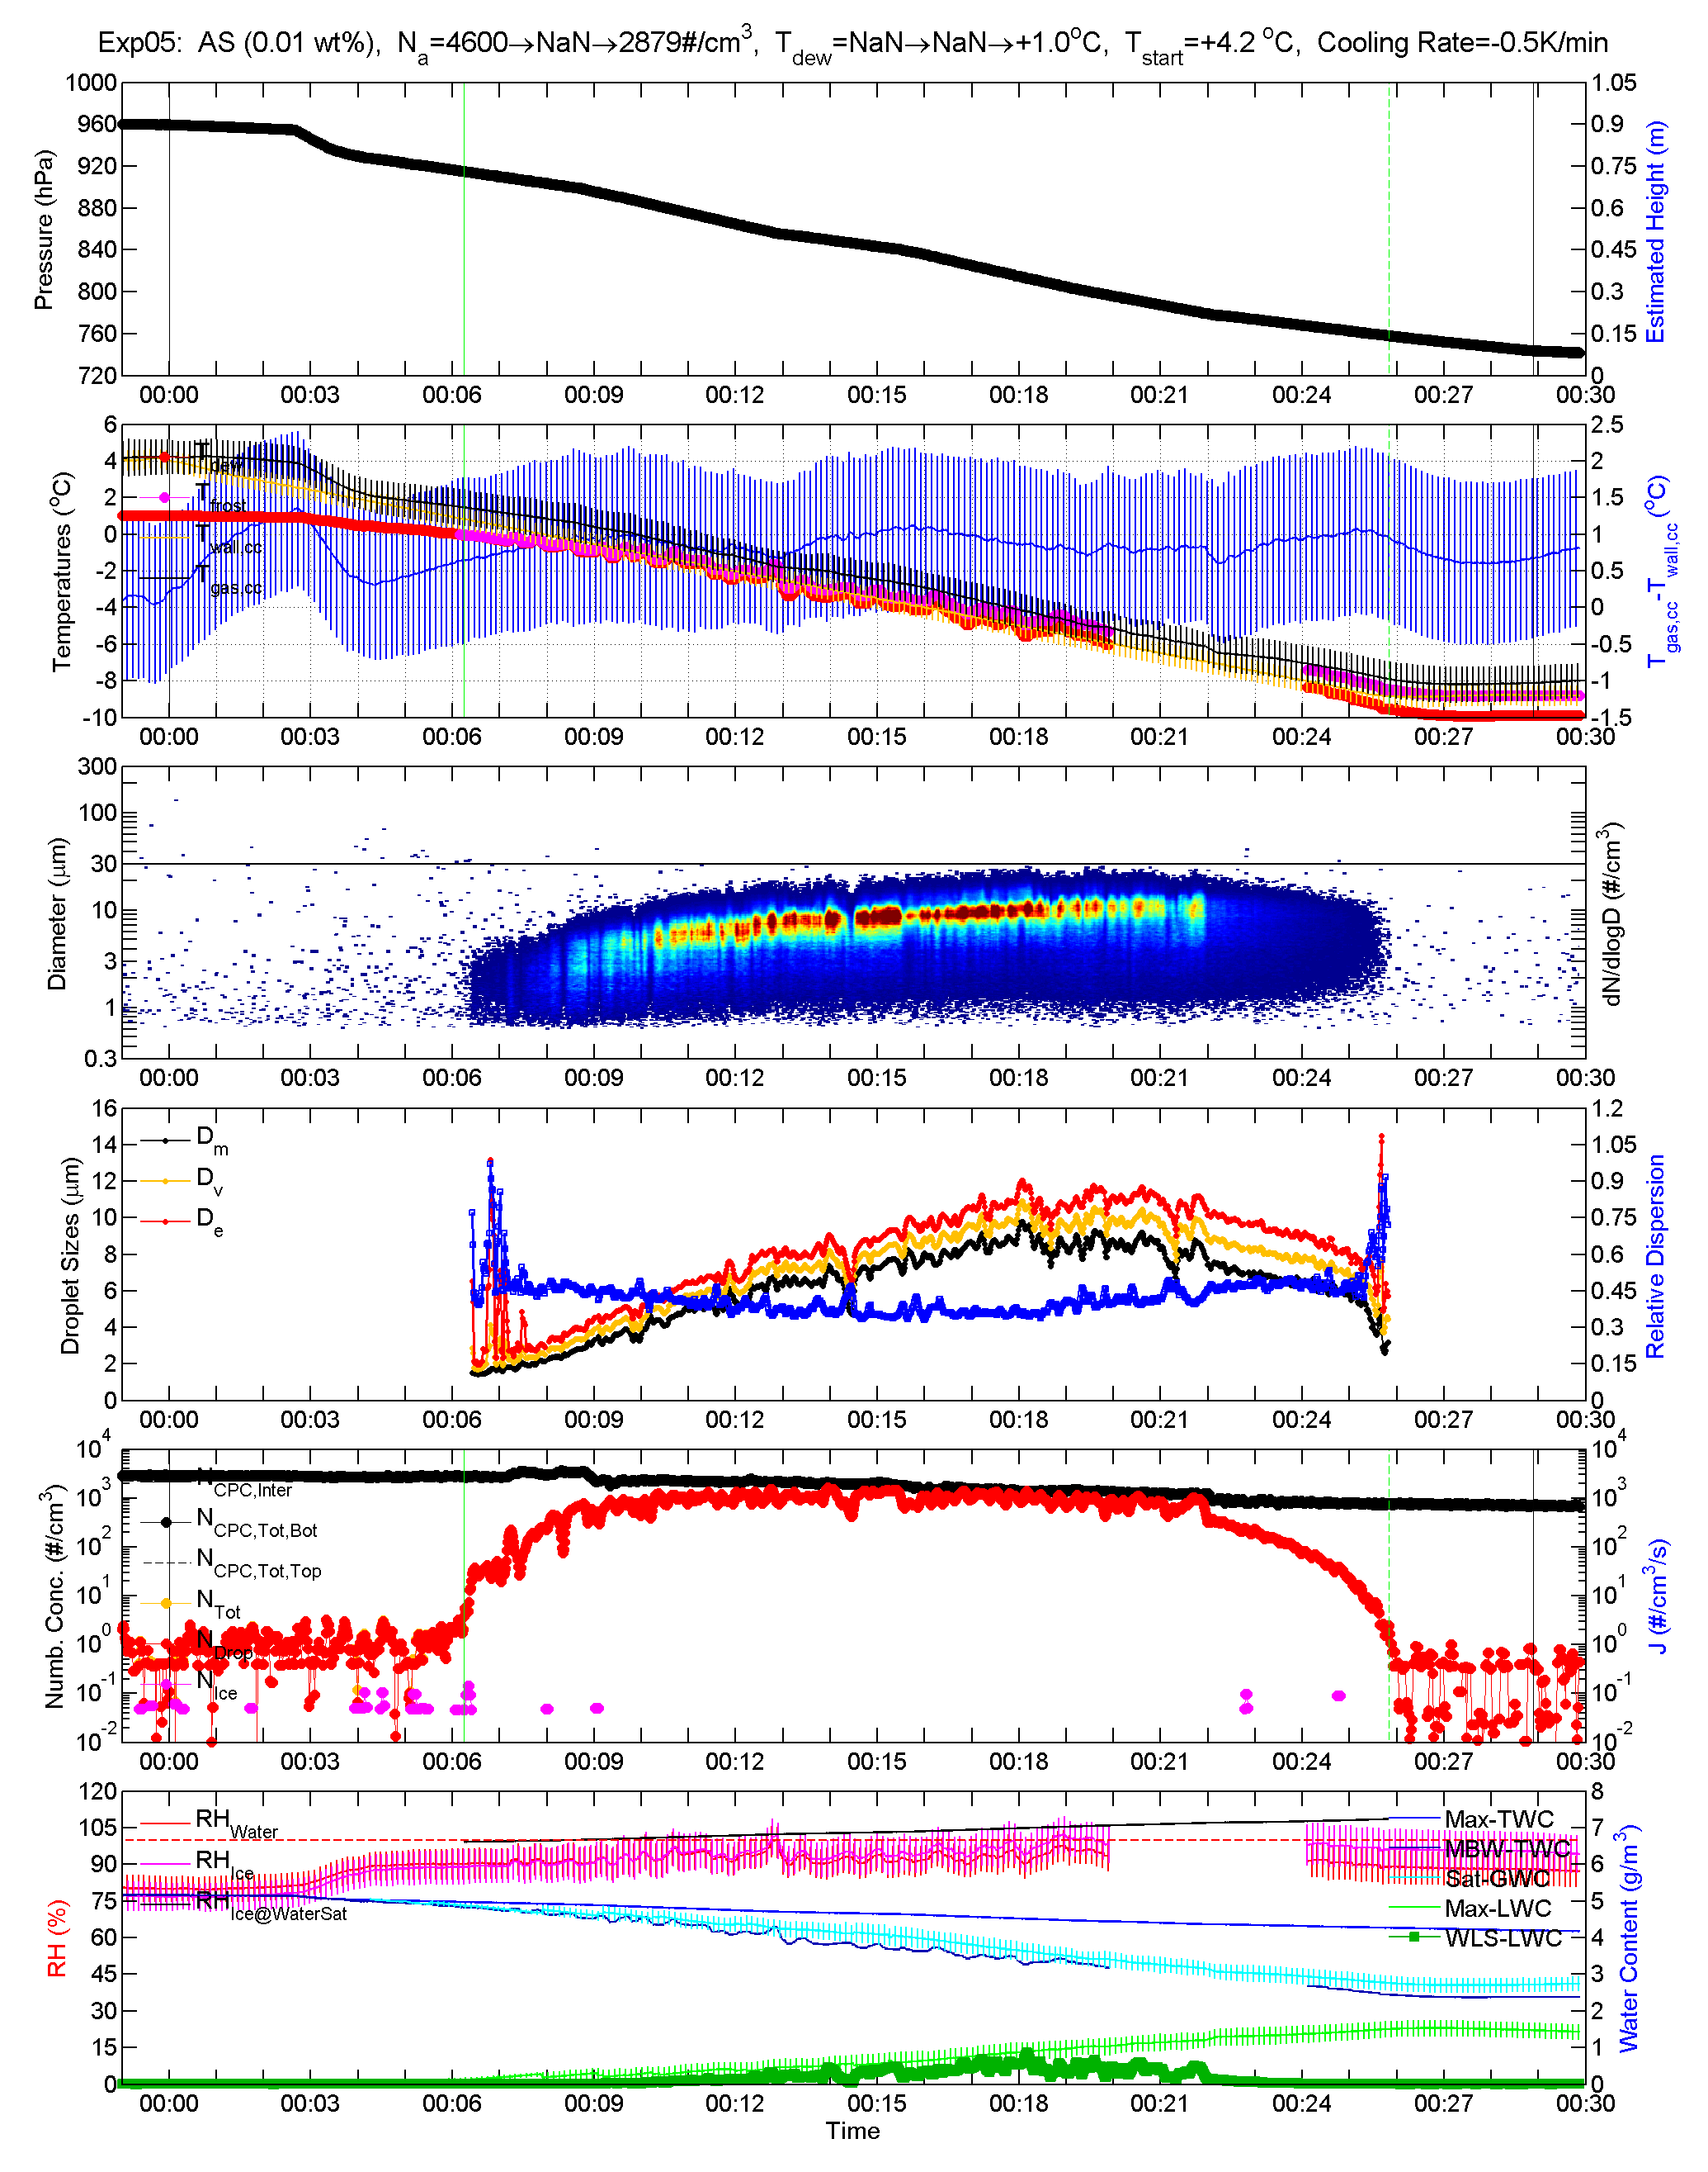
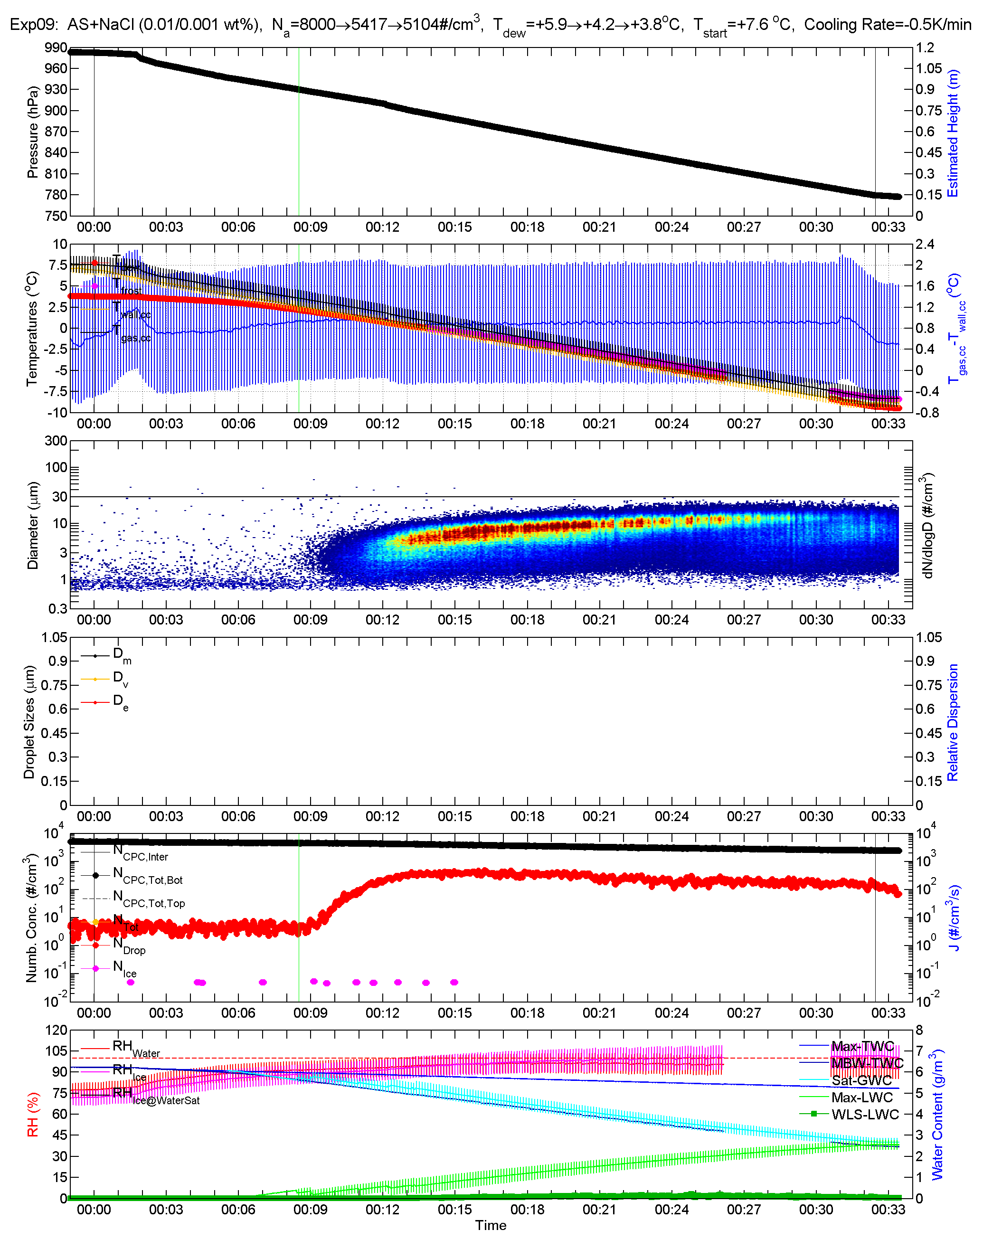
AIDAd Overview Plots – AS | AS + NaCl
xx
Xxxx
xxxxxxxxxxxxx

Slide 19
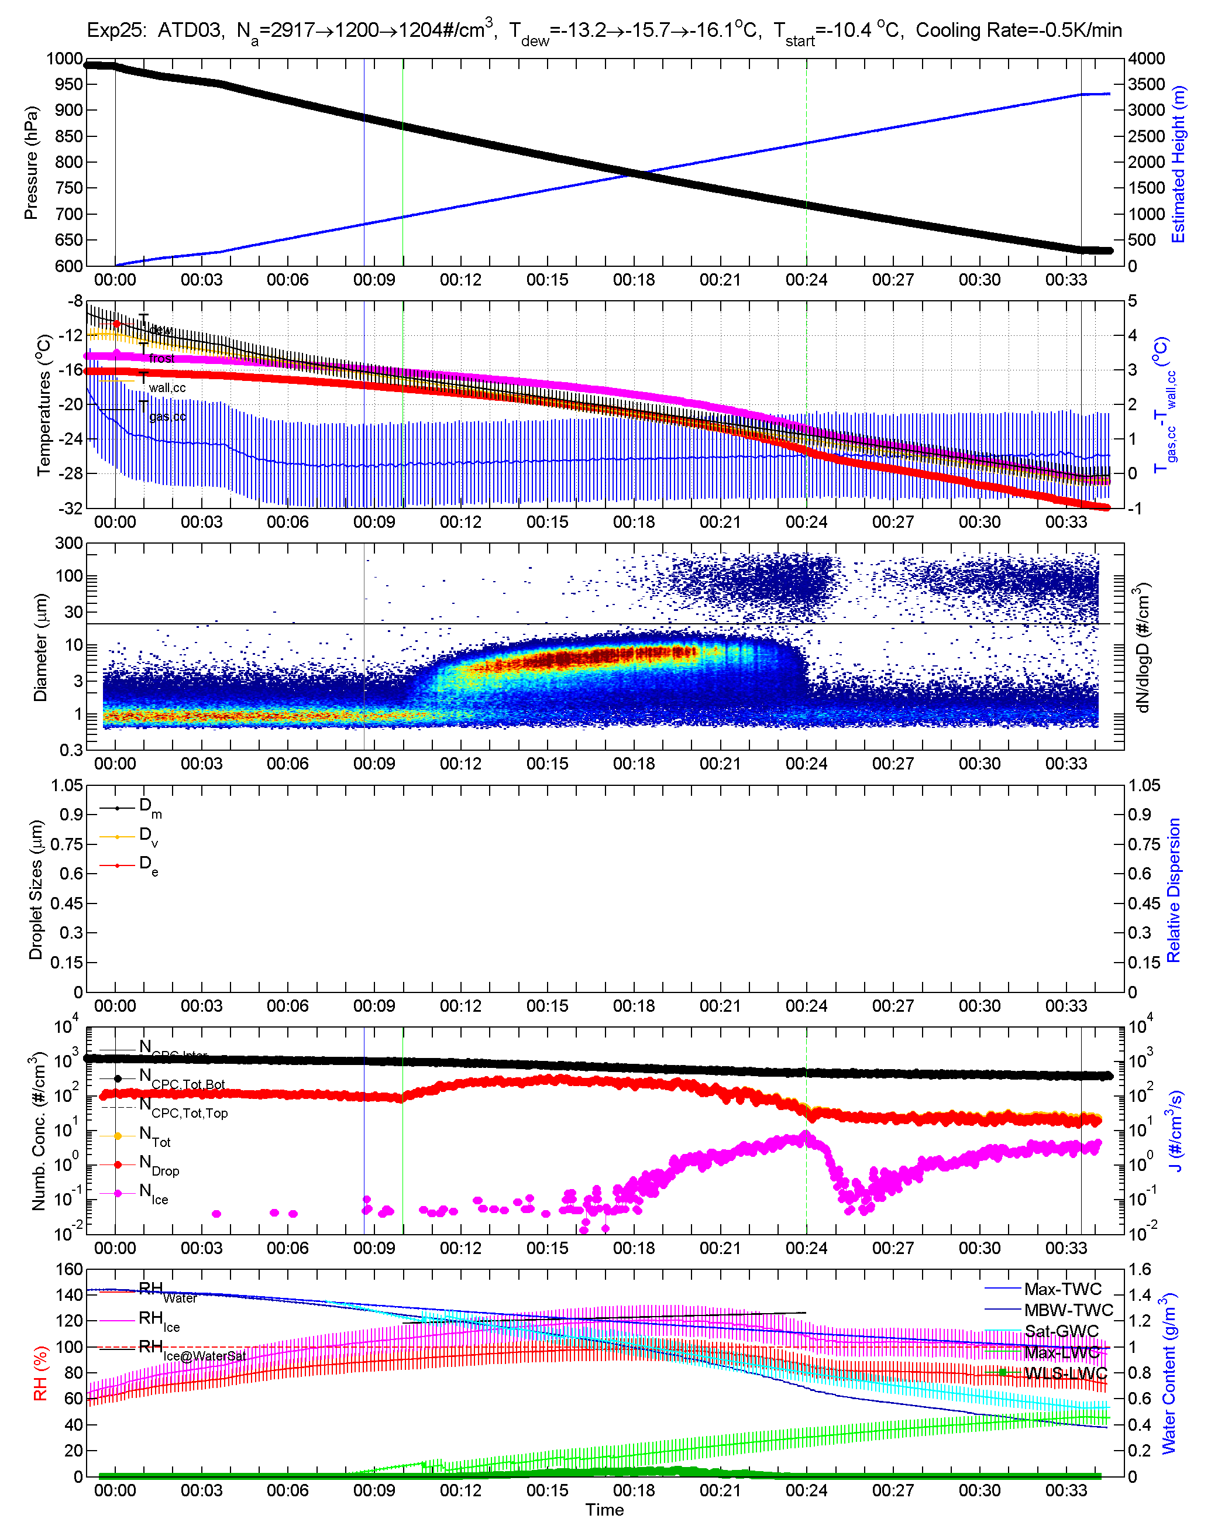
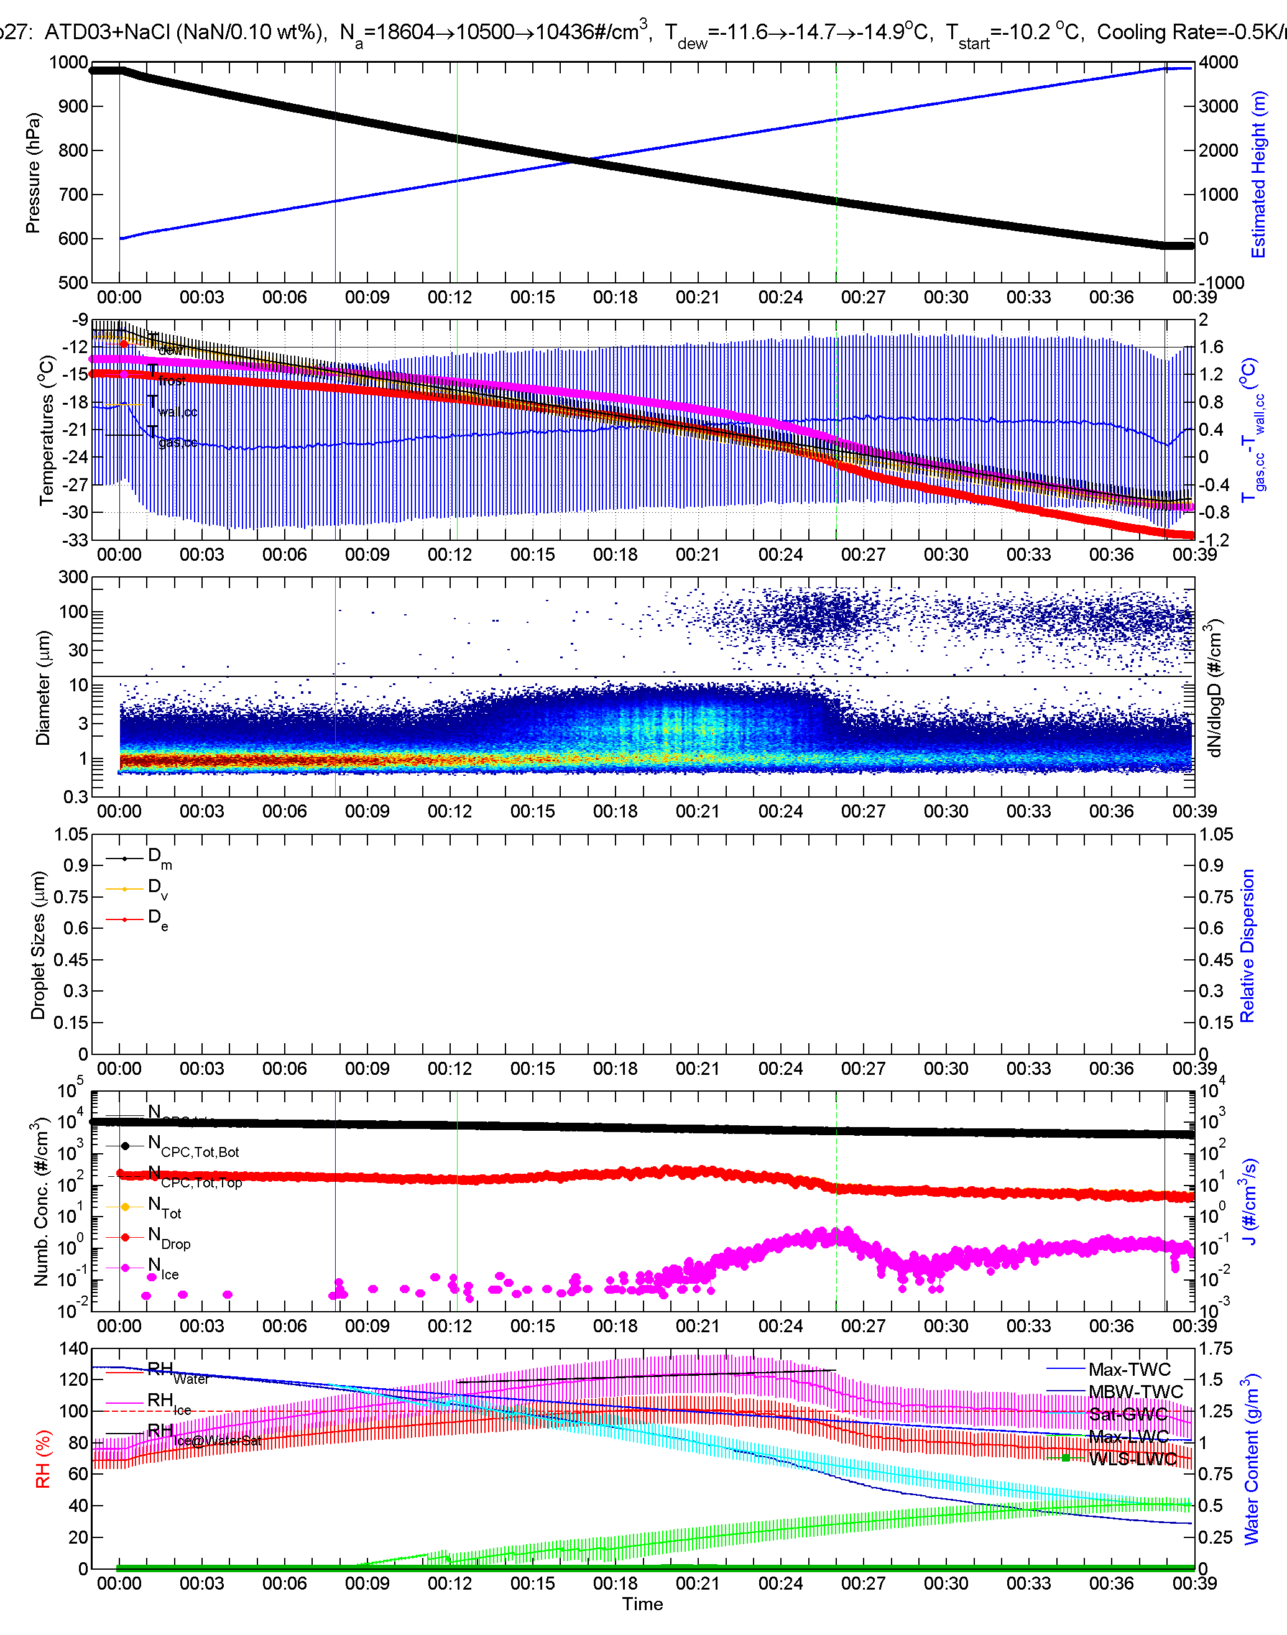
AIDAd Overview Plots – ATD | ATD + NaCl
xx
Xxxx
xxxxxxxxxxxxx

Slide 20
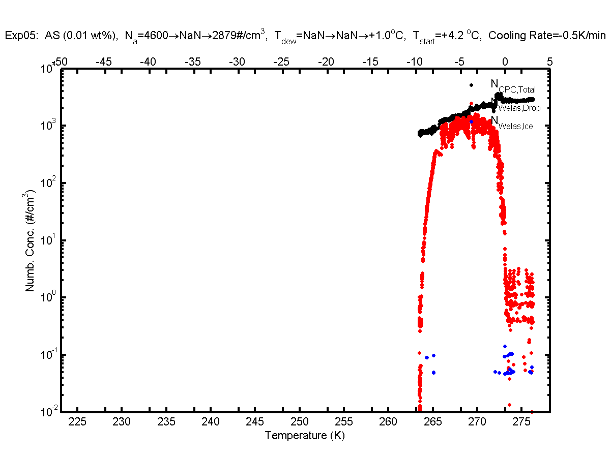
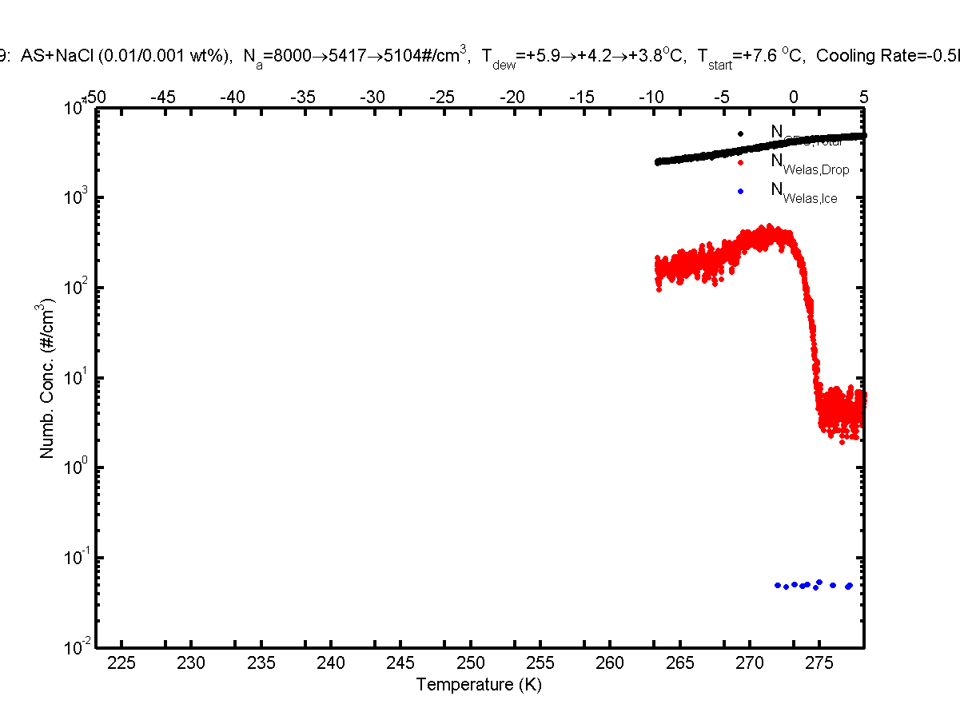
Particle Number Concentrations: AS | AS + NaCl
xxxxxxxxxxxxx
xxxxxxxxxxxxx
xxxxxxxxxxxxx

Slide 21
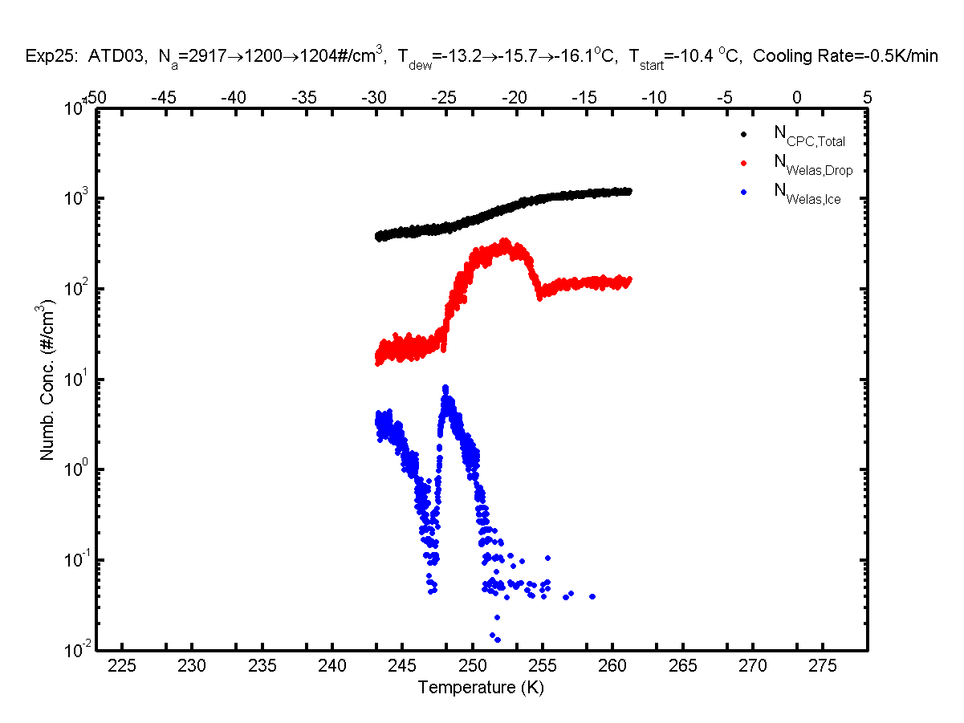
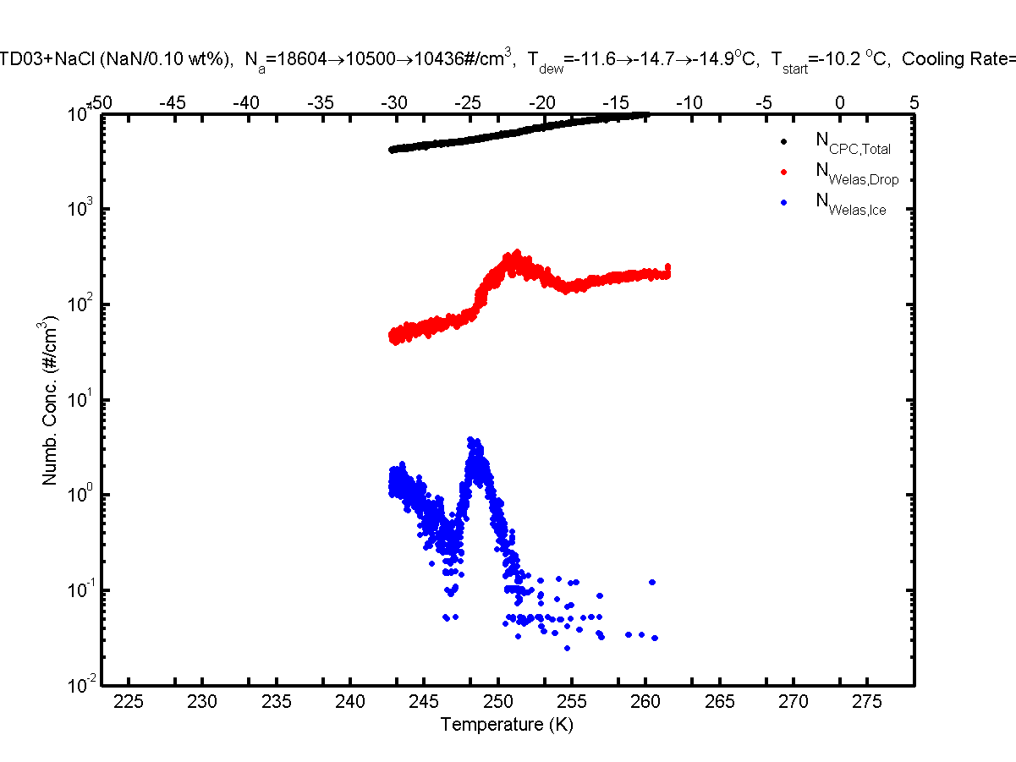
Particle Number Concentrations: AS | AS + NaCl
xxxxxxxxxxxxx
xxxxxxxxxxxxx
xxxxxxxxxxxxx

Slide 22
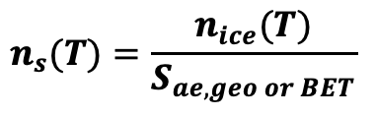
INAS density Plot: AS, NaCl, FA and ATD
Ice Nucleation Active Sites (INAS) density, n_{s} was calculated:
$$n_{s}(T)=\frac{n_{ice}(T)}{S_{ae,geo or BET}}$$

Slide 23
Summary
Competition effects were observed for the various experiments performed in the chamber.
CCN info:
More aerosol systems need to be tested…..
Umo et al. (in prep)
Notes:
Impacts of VA – Visibility, Aviation, Air quality/health, Direct influence on solar radiation (RF), Atmospheric aerosol sink/substrate for atmospheric biogeochemical reactions, Nutrient source , Ice-nucleating particles (INPs) – indirect effect

Slide 24
Pending questions and outlook…
Data analyses ongoing…
Notes:
Impacts of VA – Visibility, Aviation, Air quality/health, Direct influence on solar radiation (RF), Atmospheric aerosol sink/substrate for atmospheric biogeochemical reactions, Nutrient source , Ice-nucleating particles (INPs) – indirect effect

